Slide 1

A+ Guide to Hardware, 9th Edition
Chapter 5
Supporting the Power System and Troubleshooting Computers
Notes:
A+ Guide to Hardware, 9th Edition
Chapter 5
Supporting the Power System and Troubleshooting Computers

Slide 2
Objectives
Describe the methods and devices for keeping a system cool
Select a power supply to meet the power needs of a system
Demonstrate an organized approach to solving any computer problem, especially hardware problems occurring during the boot
Troubleshoot problems with the electrical system
Notes:
Objectives
Describe the methods and devices for keeping a system cool
Select a power supply to meet the power needs of a system
Demonstrate an organized approach to solving any computer problem, especially hardware problems occurring during the boot
Troubleshoot problems with the electrical system

Slide 3
Objectives
Troubleshoot problems with the motherboard, processor, and RAM
Troubleshoot hardware problems with mobile devices
Notes:
Objectives
Troubleshoot problems with the motherboard, processor, and RAM
Troubleshoot hardware problems with mobile devices

Slide 4
Cooling Methods and Devices
If processor, expansion cards, and other components overheat:
System can get unstable
Components can fail or be damaged
Devices used to cool a system:
Case fans
Processor coolers
Liquid cooling systems
Notes:
Cooling Methods and Devices
If processor, expansion cards, and other components overheat:
System can get unstable
Components can fail or be damaged
Devices used to cool a system:
CPU and case fans
Coolers
Heat sinks
Liquid cooling systems

Slide 5
Processor Coolers (Fans, and Heat Sinks)
Computer systems use a cooling assembly designed for a specific processor to keep temperatures below the processor maximum temperature
Good processor coolers maintain a temperature of:
90-110 degrees F (32-43 degrees C)
Cooler: sits on top of processor
Consists of a fan and heat sink
Heat sink: uses fins that draw heat away from processor
Fan: blows drawn heat away from CPU unit
Notes:
Processor Coolers, Fans, and Heat Sinks
Computer systems use a cooling assembly designed for a specific processor to keep temperatures below the processor maximum temperature
Good processor coolers maintain a temperature of:
90-110 degrees F (32-43 degrees C)
Cooler: sits on top of processor
Consists of a fan and heat sink
Heat sink: uses fins that draw heat away from processor
Fan: blows drawn heat away from CPU unit

Slide 6
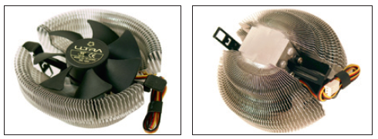
Processor Coolers (Fans, and Heat Sinks)
Figure 5-1A A cooler sits on top of a processor to help keep it cool
Notes:
Processor Coolers, Fans, and Heat Sinks

Slide 7
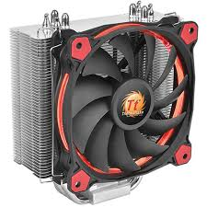
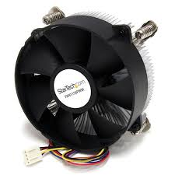
Processor Coolers (Fans, and Heat Sinks)
Figure 5-1B A cooler sits on top of a processor to help keep it cool
Notes:
Processor Coolers, Fans, and Heat Sinks

Slide 8
Processor Coolers (Fans, and Heat Sinks)
Cooler (cont’d):
Made of aluminum, copper or combination of both
Bracketed to motherboard using a wire or plastic clip
A creamlike thermal compound eliminates air pockets, helping to draw heat off the processor
Gets power by using a 4-pin fan header on the motherboard
Fanless CPU cooler (passive CPU cooler) contain heat pipes, which contain liquid that becomes vapor when heated
Vapor draws heat away from the CPU
Notes:
Processor Coolers, Fans, and Heat Sinks
Cooler (cont’d):
Made of aluminum, copper or combination of both
Bracketed to motherboard using a wire or plastic clip
A creamlike thermal compound eliminates air pockets, helping to draw heat off the processor
Gets power by using a 4-pin fan header on the motherboard
Fanless CPU cooler (passive CPU cooler) contain heat pipes, which contain liquid that becomes vapor when heated
Vapor draws heat away from the CPU

Slide 9
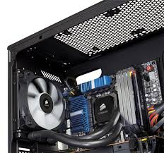
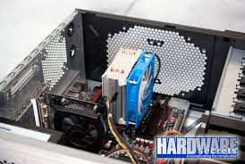
Case Fans and Other Fans and Heat Sinks
Case fans: help draw air out of the case to prevent overheating
Most cases have one or more positions on the case to hold a case fan
Large fans tend to perform better than small fans
Case fans cooler
Notes:
Case Fans and Other Fans and Heat Sinks
Case fans: help draw air out of the case to prevent overheating
Most cases have one or more positions on the case to hold a case fan
Large fans tend to perform better than small fans
Other fans:
Some graphics (video) cards come with a fan
Fan cards can be mounted next to graphics cards
Be sure to select a fan card that fits the expansion slot you plan to use

Slide 10
Case Fans and Other Fans and Heat Sinks
Other fans:
Some graphics (video) cards come with a fan
Fan cards can be mounted next to graphics cards
Be sure to select a fan card that fits the expansion slot you plan to use
Notes:
Case Fans and Other Fans and Heat Sinks
Case fans: help draw air out of the case to prevent overheating
Most cases have one or more positions on the case to hold a case fan
Large fans tend to perform better than small fans
Other fans:
Some graphics (video) cards come with a fan
Fan cards can be mounted next to graphics cards
Be sure to select a fan card that fits the expansion slot you plan to use

Slide 11
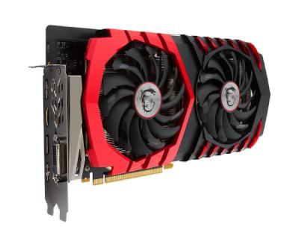
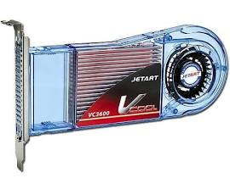
Case Fans and Other Fans and Heat Sinks
Graphic card coolers
Notes:
Case Fans and Other Fans and Heat Sinks
Case fans: help draw air out of the case to prevent overheating
Most cases have one or more positions on the case to hold a case fan
Large fans tend to perform better than small fans
Other fans:
Some graphics (video) cards come with a fan
Fan cards can be mounted next to graphics cards
Be sure to select a fan card that fits the expansion slot you plan to use

Slide 12
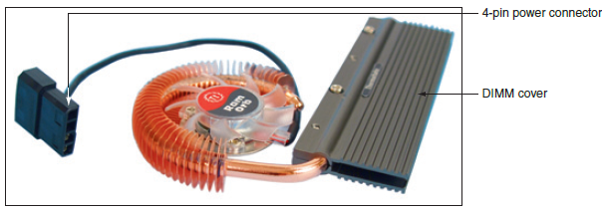
Case Fans and Other Fans and Heat Sinks
Other fans (cont’d):
RAM cooler – clips over a DIMM memory module
May be powered by a SATA or 4-pin Molex power connector
Figure 5-7 A RAM cooler keeps memory modules cool
Notes:
Case Fans and Other Fans and Heat Sinks
Other fans (cont’d):
RAM cooler – clips over a DIMM memory module
May be powered by a SATA or 4-pin Molex power connector

Slide 13
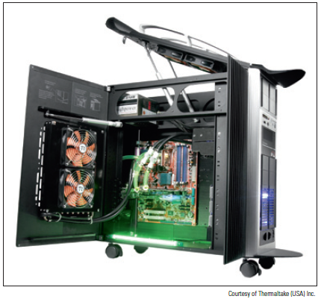
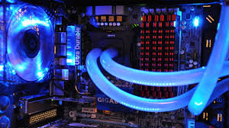
Liquid Cooling Systems
Liquid cooling system
A small pump sits inside the case and tubes moves liquid around components and then away from them to a place where fans cool the liquid
Figure 5-8 A liquid cooling system pumps
liquid outside and away from components
where fans can then cool the liquid
Notes:
Liquid Cooling Systems
Liquid cooling system
A small pump sits inside the case and tubes moves liquid around components and then away from them to a place where fans cool the liquid

Slide 14
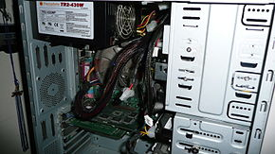
Selecting a Power Supply
Reasons to replace a power supply:
Power supply in existing system fails
Power supply in existing system is not adequate
When building from scratch, some cases come with power supply already installed
Installed power supply
Notes:
Selecting a Power Supply
Reasons to replace a power supply:
Power supply in existing system fails
Power supply in existing system is not adequate
When building from scratch, some cases come with power supply already installed

Slide 15
Types and Characteristics of Power Supplies
Important power supply feature considerations:
Form factor determines power supply size
Wattage ratings (listed in documentation)
Number and type of connectors
Fans inside the PSU
Dual voltage options
Warranty and overall quality
Notes:
Types and Characteristics of Power Supplies
Important power supply feature considerations:
Form factor determines power supply size
Wattage ratings (listed in documentation)
Number and type of connectors
Fans inside the PSU
Dual voltage options
Warranty and overall quality

Slide 16
How to Calculate Wattage Capacity
Determining wattage capacity
Consider all components inside case
Consider USB and FireWire devices
Get power from ports connected to the motherboard
Points to keep in mind
Video cards draw the most power
The power supply should be rated 30 percent higher than expected needs
What size Power Supply?
Add up wattage requirements and add 30 percent
Notes:
How to Calculate Wattage Capacity
Determining wattage capacity
Consider all components inside case
Consider USB and FireWire devices
Get power from ports connected to the motherboard
Points to keep in mind
Video cards draw the most power
The power supply should be rated 30 percent higher than expected needs
What size Power Supply?
Add up wattage requirements and add 30 percent

Slide 17
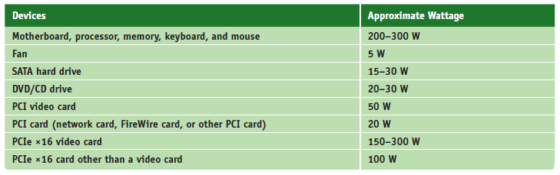
How to Calculate Wattage Capacity
Table 5-2 To calculate the power supply rating you need, add up total wattage
Notes:
How to Calculate Wattage Capacity

Slide 18
How to Approach a Hardware Problem
Troubleshooting resources:
The web (Internet)
Chat forums or email technical support
Manufacturer’s diagnostic software
User manuals
Technical associates in your organization
Notes:
How to Approach a Hardware Problem
Troubleshooting resources:
The web (Internet)
Chat forums or email technical support
Manufacturer’s diagnostic software
User manuals
Technical associates in your organization

Slide 19
Step 1: Interview the User
Include these questions:
Can you describe the problem, when did it first start, and when does it occur?
Was the computer recently moved?
Was any new hardware or software recently installed?
Was any software recently reconfigured or upgraded?
Did someone else use your computer recently?
Notes:
Step 1: Interview the User
Include these questions:
Can you describe the problem, when did it first start, and when does it occur?
Was the computer recently moved?
Was any new hardware or software recently installed?
Was any software recently reconfigured or upgraded?
Did someone else use your computer recently?

Slide 20
Step 1: Interview the User
Include these questions (cont’d):
Does the computer have a history of similar problems?
Is there important data on the drive that is not backed up?
Can you show me how to reproduce the problem?
After gathering information:
Prioritize what to do and begin diagnosing and addressing the problem
Notes:
Step 1: Interview the User
Include these questions (cont’d):
Does the computer have a history of similar problems?
Is there important data on the drive that is not backed up?
Can you show me how to reproduce the problem?
After gathering information:
Prioritize what to do and begin diagnosing and addressing the problem

Slide 21
Step 2: Back Up Data As Needed
Three options for backing up data:
Move the hard drive to another system
Use file recovery software
Hire a professional file recovery service
Before selecting a service, read reviews, understand the warranty and guarantees, and get a customer recommendation
Notes:
Step 2: Back Up Data As Needed
Three options for backing up data:
Move the hard drive to another system
Use file recovery software
Hire a professional file recovery service
Before selecting a service, read reviews, understand the warranty and guarantees, and get a customer recommendation

Slide 22
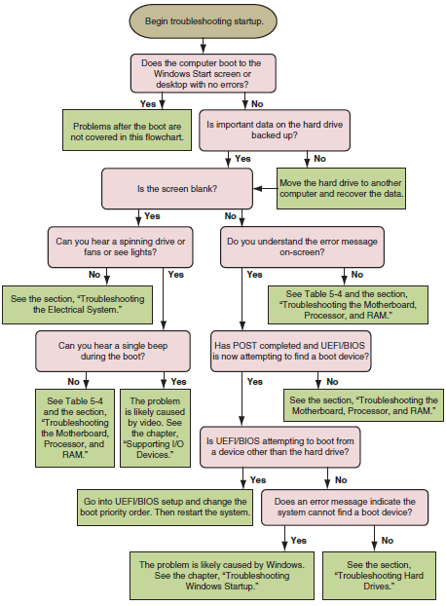
Step 3: Examine the System and Establish a Theory
Figure 5-16 Use this flowchart when first facing a computer problem
Notes:
Step 3: Examine the System and Establish a Theory

Slide 23
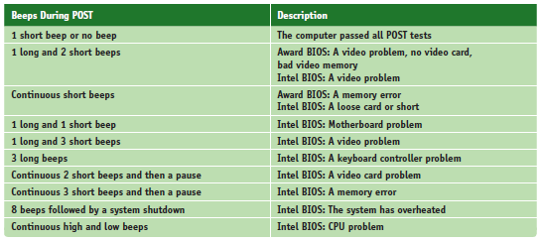
Step 3: Examine the System and Establish a Theory
Table 5-5 Common beep codes and their meanings for Intel and Aware BIOS
Notes:
Step 3: Examine the System and Establish a Theory

Slide 24
Steps 4, 5, and 6: Fix the Problem, Verify the Fix, and Document the Outcome
After understanding the problem
Plan steps to resolve the problem
After the fix
Verify the system works by performing one last hard boot and making sure everything works as expected
Ask if anything could have been done to prevent the problem, if so, take preventative action
Most organization require documentation in a call tracking or helpdesk application
Record findings
Notes:
Steps 4, 5, and 6: Fix the Problem, Verify the Fix, and Document the Outcome
After understanding the problem
Plan steps to resolve the problem
After the fix
Verify the system works by performing one last hard boot and making sure everything works as expected
Ask if anything could have been done to prevent the problem, if so, take preventative action
Most organization require documentation in a call tracking or helpdesk application
Record findings

Slide 25
Special Concerns when Troubleshooting Mobile Device Hardware
Factors to consider before starting repair project:
Warranty
Time the repair will take
Alternatives to repairing (upgrading)
Return notebook to manufacturer or service center
Substitute external component for internal device
Replace the internal device
Notes:
Special Concerns when Troubleshooting Mobile Device Hardware
Factors to consider before starting repair project:
Warranty
Time the repair will take
Alternatives to repairing (upgrading)
Return notebook to manufacturer or service center
Substitute external component for internal device
Replace the internal device

Slide 26
Troubleshooting the Electrical System
Electrical problems can:
Occur before or after the boot
Be consistent or intermittent
Possible symptoms of electrical problem:
Computer appears to be “dead”
Computer sometimes locks up during booting
Error codes or beeps occur during booting
Smell burnt parts or odors
Computer powers down at unexpected times
Computer appears dead except you hear a whine coming from the power supply
Notes:
Troubleshooting the Electrical System
Electrical problems can:
Occur before or after the boot
Be consistent or intermittent
Possible symptoms of electrical problem:
Computer appears to be “dead”
Computer sometimes locks up during booting
Error codes or beeps occur during booting
Smell burnt parts or odors
Computer powers down at unexpected times
Computer appears dead except you hear a whine coming from the power supply

Slide 27
Troubleshooting the Electrical System
Try these simple things first:
If you smell any burnt part, don’t turn system on
Find fried part and replace
If power supply is whining, don’t turn system on
Open case and look for short or consider upgrading
Test power supply with a power supply tester
Check power cord connection and power bar it may be plugged into
Is power outlet controlled by wall switch? If so, turn it on
Are any cable connections loose?
Notes:
Troubleshooting the Electrical System
Try these simple things first:
If you small any burnt part, don’t turn system on
Find fried part and replace
If power supply is whining, don’t turn system on
Open case and look for short or consider upgrading
Test power supply with a power supply tester
Check power cord connection and power bar it may be plugged into
Is power outlet controlled by wall switch? If so, turn it on
Are any cable connections loose?

Slide 28
Troubleshooting the Electrical System
Try these simple things first (cont’d):
Is the circuit breaker blown? Is the house circuit overloaded?
Are all switches on the system turned on?
Is it possible the system has overheated? If so, wait awhile and try again
Older computers might be affected by electromagnetic interference (EMI)
Check for sources of EMI such as fluorescent lighting or an electric fan or copier sitting near PC
Notes:
Troubleshooting the Electrical System
Try these simple things first (cont’d):
Is the circuit breaker blown? Is the house circuit overloaded?
Are all switches on the system turned on?
Is it possible the system has overheated? If so, wait awhile and try again
Older computers might be affected by electromagnetic interference (EMI)
Check for sources of EMI such as fluorescent lighting or an electric fan or copier sitting near PC

Slide 29
Troubleshooting the Electrical System
Problem still not solved, look inside the case:
Check all power connections from the power supply to the motherboard and drives
If you smell burnt parts, search for shorts and frayed and burnt wires
If you suspect the power supply is bad, test it with a power supply tester
Notes:
Troubleshooting the Electrical System
Problem still not solved, look inside the case:
Check all power connections from the power supply to the motherboard and drives
If you smell burnt parts, search for shorts and frayed and burnt wires
If you suspect the power supply is bad, test it with a power supply tester

Slide 30
Problems That Come and Go
Generally, intermittent problems are more difficult to solve
Symptoms of what may be an intermittent problem:
Computer stops or hangs for no reason
Memory errors appear intermittently
Data is written incorrectly to the hard drive
Keyboard stops working at odd times
Motherboard fails
Power supply overheats and becomes hot to touch
Power supply fan whines and becomes noisy
Notes:
Problems That Come and Go
Generally, intermittent problems are more difficult to solve
Symptoms of what may be an intermittent problem:
Computer stops or hangs for no reason
Memory errors appear intermittently
Data is written incorrectly to the hard drive
Keyboard stops working at odd times
Motherboard fails or is damaged
Power supply overheats and becomes hot to touch
Power supply fan whines and becomes noisy

Slide 31
Problems That Come and Go
Eliminate the electrical system as the source of an intermittent problem:
Consider the power supply is inadequate
Suspect the power supply is faulty
The power supply fan might not work
Notes:
Problems That Come and Go
Eliminate the electrical system as the source of an intermittent problem:
Consider the power supply is inadequate
Suspect the power supply is faulty
The power supply fan might not work

Slide 32
Power Problems With the Motherboard
Short might occur if a motherboard component makes improper contact with the chassis
Can seriously damage the motherboard
Check for missing/loose standoffs or loose screws
Shorts in motherboard circuits might also cause problems
Look for damage on the bottom of the motherboard
Look for burned-out capacitors that are spotted brown or corroded
Notes:
Power Problems With the Motherboard
Short might occur if a motherboard component makes improper contact with the chassis
Can seriously damage the motherboard
Check for missing/loose standoffs or loose screws
Shorts in motherboard circuits might also cause problems
Look for damage on the bottom of the motherboard
Look for burned-out capacitors that are spotted brown or corroded

Slide 33
Problems With Overheating
Symptoms of overheating:
System hangs or freezes at odd times or after the boot starts
Windows BSOD (blue screen of death) error occurs during the boot
You cannot hear a fan running or the fan makes a whining sound
You cannot feel air being pulled into or out of the case
You can purchase a temperature sensor that will sound an alarm when the inside of the case is too hot
Notes:
Problems With Overheating
Symptoms of overheating:
System hangs or freezes at odd times or after the boot starts
Windows BSOD (blue screen of death) error occurs during the boot
You cannot hear a fan running or the fan makes a whining sound
You cannot feel air being pulled into or out of the case
You can purchase a temperature sensor that will sound an alarm when the inside of the case is too hot

Slide 34
Problems With Overheating
Things to do to solve overheating:
If system hangs, go into UEFI/BIOS setup and find the CPU screen that reports temperature (should not exceed that recommended by the CPU manufacturer)
Use compressed air, a blower, or antistatic vacuum to remove dust from the power supply and vents
Check airflow inside the case to see if fans are running (may need to replace a fan)
Install extra fans if case will hold them
Can the side of the case hold a chassis air guide that guides air to the processor? If so, install one
Notes:
Problems With Overheating
Things to do to solve overheating:
If system hangs, go into UEFI/BIOS setup and find the CPU screen that reports temperature (should not exceed that recommended by the CPU manufacturer)
Use compressed air, a blower, or antistatic vacuum to remove dust from the power supply and vents
Check airflow inside the case to see if fans are running (may need to replace a fan)
Install extra fans if case will hold them
Can the side of the case hold a chassis air guide that guides air to the processor? If so, install one

Slide 35
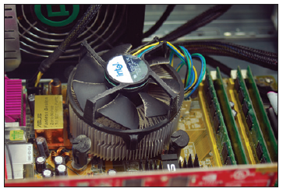
Problems With Overheating
Figure 5-20 Dust in the cooler fan can cause the fan to fail and the processor to overheat
Notes:
Problems With Overheating
Things to do to solve overheating:
If system hangs, go into UEFI/BIOS setup and find the CPU screen that reports temperature (should not exceed that recommended by the CPU manufacturer)
Use compressed air, a blower, or antistatic vacuum to remove dust from the power supply and vents
Check airflow inside the case to see if fans are running (may need to replace a fan)
Install extra fans if case will hold them
Can the side of the case hold a chassis air guide that guides air to the processor? If so, install one

Slide 36
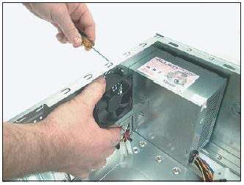
Problems With Overheating
Figure 5-21 Install one exhaust fan on the rear of the case to help pull air through the case
Notes:
Problems With Overheating
Things to do to solve overheating:
If system hangs, go into UEFI/BIOS setup and find the CPU screen that reports temperature (should not exceed that recommended by the CPU manufacturer)
Use compressed air, a blower, or antistatic vacuum to remove dust from the power supply and vents
Check airflow inside the case to see if fans are running (may need to replace a fan)
Install extra fans if case will hold them
Can the side of the case hold a chassis air guide that guides air to the processor? If so, install one

Slide 37
Problems With Overheating
Things to do to solve overheating (cont’d):
To improve airflow, replace missing faceplates and expansion slot covers
Ensure cables are not in the way of airflow
Place case so that there are a few inches of space on both sides and the top of the case
Verify the cooler is connected properly to the processor
After closing the case, leave system off for at least 30 minutes
Notes:
Problems With Overheating
Things to do to solve overheating (cont’d):
To improve airflow, replace missing faceplates and expansion slot covers
Ensure cables are not in the way of airflow
Place case so that there are a few inches of space on both sides and the top of the case
Verify the cooler is connected properly to the processor
After closing the case, leave system off for at least 30 minutes

Slide 38
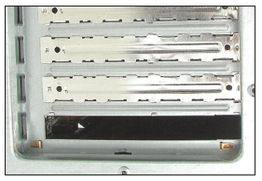
Problems With Overheating
Figure 5-22 For optimum airflow, don’t leave empty expansion slots and bays uncovered
Notes:
Problems With Overheating

Slide 39
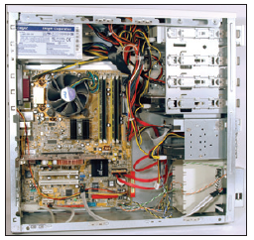
Problems With Overheating
Figure 5-23 Use cable ties to hold cables out of the way of fans and airflow
Notes:
Problems With Overheating

Slide 40
Problems With Overheating
Things to do to solve overheating (cont’d):
Check UEFI/BIOS setup to see if the processor is being overclocked (can cause system to overheat)
Have too many peripherals been installed inside the case? Try to leave an empty slot between each card
Flash UEFI/BIOS to update firmware on motherboard
Replace thermal compound if it has hardened
Notes:
Problems With Overheating
Things to do to solve overheating (cont’d):
Check UEFI/BIOS setup to see if the processor is being overclocked (can cause system to overheat)
Have too many peripherals been installed inside the case? Try to leave an empty slot between each card
Flash UEFI/BIOS to update firmware on motherboard
Replace thermal compound if it has hardened

Slide 41
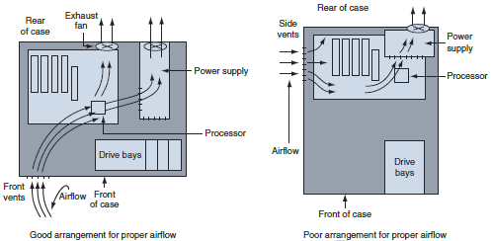
Problems With Overheating
Figure 5-25 Vents and fans need to be arranged for best airflow
Notes:
Problems With Overheating

Slide 42
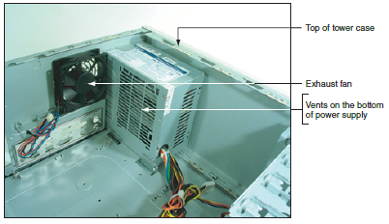
Problems With Overheating
Use a power supply that has vents on the bottom and front for better ventilation
Figure 5-26 This power supply has vents on the bottom to provide better airflow inside the case
Notes:
Problems With Overheating
Use a power supply that has vents on the bottom and front for better ventilation

Slide 43
Problems With Overheating
An intake fan on the front of the case might help pull air into the case
Check with processor and case manufacturers
For specific instructions as to the placement of fans and what type of fan and heat sink to use
Intel and AMD recommend a chassis air guide (CAG) as part of the case design
A round air duct that helps pull and direct fresh air from outside the case to the cooler and processor
Notes:
Problems With Overheating
An intake fan on the front of the case might help pull air into the case
Check with processor and case manufacturers
For specific instructions as to the placement of fans and what type of fan and heat sink to use
Intel and AMD recommend a chassis air guide (CAG) as part of the case design
A round air duct that helps pull and direct fresh air from outside the case to the cooler and processor

Slide 44
Problems with Laptop Power Systems
Laptop power sources
AC adapter or a battery pack
Today’s batteries use lithium-ion technology
Auto-switching AC adapter feature
Device automatically switches from 110 V to 220 V AC power
Some laptops use two batteries
Second battery is known as a sheet battery
Notes:
Problems with Laptop Power Systems
Laptop power sources
AC adapter or a battery pack
Today’s batteries use lithium ion technology
Auto-switching AC adapter feature
Device automatically switches from 110 V to 220 V AC power
Some laptops use two batteries
Second battery is known as a sheet battery

Slide 45
Problems with Laptop Power Systems
If power is not getting to the system or battery indicator light is lit:
Verify the AC adapter is plugged into an outlet
Check if AC adapter’s plug is secure outlet
Check connections on both sides of AC adapter transformer
Check connection at notebook
If battery is not charging when AC adapter is plugged in, problem might be with battery or motherboard
Notes:
Problems with Laptop Power Systems
If power is not getting to the system or battery indicator light is lit:
Verify the AC adapter is plugged into an outlet
Check if AC adapter’s plug is secure outlet
Check connections on both sides of AC adapter transformer
Check connection at notebook
If battery is not charging when AC adapter is plugged in, problem might be with battery or motherboard

Slide 46
Troubleshooting the Motherboard, Processor, and RAM
Symptoms that a motherboard, processor, or memory is failing:
System begins to boot but then powers down
Error message is displayed during the boot
System reports less memory than installed
System becomes unstable, hangs, or freezes
Intermittent Windows or hard drive errors occur
Components on the motherboard or devices connected to it don’t work
Check simple things first
Notes:
Troubleshooting the Motherboard, Processor, and RAM
Symptoms that a motherboard, processor, or memory is failing:
System begins to boot but then powers down
Error message is displayed during the boot
System reports less memory than installed
System becomes unstable, hangs, or freezes
Intermittent Windows or hard drive errors occur
Components on the motherboard or devices connected to it don’t work
Check simple things first

Slide 47
Troubleshooting the Motherboard, Processor, and RAM
Follow these steps to find source of problem:
1. Search the Internet for the error message
2. Run antivirus software to check for viruses
3. A memory module might be failing
Use Memory Diagnostics tool to test memory
4. Check for potential hardware problems using Device Manager
5. Download and install any Windows updates or patches
6. If problem began after a change or new install, uninstall device or application
Notes:
Troubleshooting the Motherboard, Processor, and RAM
Follow these steps to find source of problem:
1. Search the Internet for the error message
2. Run antivirus software to check for viruses
3. A memory module might be failing
Use Memory Diagnostics tool to test memory
4. Check for potential hardware problems using Device Manager
5. Download and install any Windows updates or patches
6. If problem began after a change or new install, uninstall device or application

Slide 48
Troubleshooting the Motherboard, Processor, and RAM
Follow these steps to find source of problem (cont’d):
7. Use System window to find out how much RAM is installed (consider upgrading if not enough)
8. Check UEFI/BIOS setup to ensure proper settings
9. Disable any quick booting features in BIOS
Then look for errors reported during the boot
10. Flash BIOS to update firmware on the board
11. Check CD that came with motherboard
May have diagnostic tests
12. Update all drivers of motherboard components that are not working
Notes:
Troubleshooting the Motherboard, Processor, and RAM
Follow these steps to find source of problem (cont’d):
7. Use System window to find out how much RAM is installed (consider upgrading if not enough)
8. Check UEFI/BIOS setup to ensure proper settings
9. Disable any quick booting features in BIOS
Then look for errors reported during the boot
10. Flash BIOS to update firmware on the board
11. Check CD that came with motherboard
May have diagnostic tests
12. Update all drivers of motherboard components that are not working

Slide 49
Troubleshooting the Motherboard, Processor, and RAM
Follow these steps to find source of problem (cont’d):
13. If an onboard port is not working:
Verify the problem is not with the device using the port
Go into UEFI/BIOS setup and verify the port is enabled
Check Device Manager and verify Windows recognizes port with no errors
Update motherboard drivers for this port from manufacturer’s web site
Use a loop-back plug to test the port
Disable the port in BIOS setup and install an expansion card
Notes:
Troubleshooting the Motherboard, Processor, and RAM
Follow these steps to find source of problem (cont’d):
13. If an onboard port is not working:
Verify the problem is not with the device using the port
Go into UEFI/BIOS setup and verify the port is enabled
Check Device Manager and verify Windows recognizes port with no errors
Update motherboard drivers for this port from manufacturer’s web site
Use a loop-back plug to test the port
Disable the port in BIOS setup and install an expansion card

Slide 50
Troubleshooting the Motherboard, Processor, and RAM
Follow these steps to find source of problem (cont’d):
14. Suspect the problem is a failing hard drive
15. Suspect the problem is caused by overheating
16. Verify the installed processor is supported by the motherboard
Notes:
Troubleshooting the Motherboard, Processor, and RAM
Follow these steps to find source of problem (cont’d):
14. Suspect the problem is a failing hard drive
15. Suspect the problem is caused by overheating
16. Verify the installed processor is supported by the motherboard

Slide 51
Troubleshooting the Motherboard, Processor, and RAM
If you have checked Windows and UEFI/BIOS settings and have not identified the source of the problem, open the case and check inside
With the case open, follow these steps:
1. Check that all power and data cables are securely connected
2. Look for physical damage on the motherboard
3. Reduce the system to essentials
4. Try using a POST diagnostic card
5. Suspect the problem is caused by a failing power supply
Notes:
Troubleshooting the Motherboard, Processor, and RAM
If you have checked Windows and UEFI/BIOS settings and have not identified the source of the problem, open the case and check inside
With the case open, follow these steps:
1. Check that all power and data cables are securely connected
2. Look for physical damage on the motherboard
3. Reduce the system to essentials
4. Try using a POST diagnostic card
5. Suspect the problem is caused by a failing power supply

Slide 52
Troubleshooting the Motherboard, Processor, and RAM
With the case open, follow these steps (cont’d):
6. Exchange the processor
7. Exchange the motherboard
Before you do this, measure the voltage output of the power supply or replace it (in case it damaged the motherboard)
Notes:
Troubleshooting the Motherboard, Processor, and RAM
With the case open, follow these steps (cont’d):
6. Exchange the processor
7. Exchange the motherboard
Before you do this, measure the voltage output of the power supply or replace it (in case it damaged the motherboard)

Slide 53
Troubleshooting Mobile Devices
Solutions for a cell phone that is overheating:
Check if heat is coming from the bottom of cell phone, where battery is located
Use different AC adapter to charge battery
Examine battery for damage (if no longer under warranty)
If heat is coming from other areas of the phone:
Too many apps might be open
Follow troubleshooting steps for phone’s OS
Phone processor might be overworked (allow to cool)
Remove phone from case
Notes:
Troubleshooting Mobile Devices
Solutions for a cell phone that is overheating:
Check if heat is coming from the bottom of cell phone, where battery is located
Use different AC adapter to charge battery
Examine battery for damage (if no longer under warranty)
If heat is coming from other areas of the phone:
Too many apps might be open
Follow troubleshooting steps for phone’s OS
Phone processor might be overworked (allow to cool)
Remove phone from case

Slide 54
Troubleshooting Mobile Devices
Other problems and solutions:
For a frozen system:
For iPhone or iPad, reset the device
For Android device, reboot the system by following manufacturer directions for a reboot
For Windows Phone, hold down the Power button and then swipe Slide down to power off
Battery charge lasts a short time
Try exchanging the AC adapter
If that doesn’t work, exchange battery unless device is under warranty
Notes:
Troubleshooting Mobile Devices
Other problems and solutions:
For a frozen system:
For iPhone or iPad, reset the device
For Android device, reboot the system by following manufacturer directions for a reboot
For Windows Phone, hold down the Power button and then swipe Slide down to power off
Battery charge lasts a short time
Try exchanging the AC adapter
If that doesn’t work, exchange battery unless device is under warranty

Slide 55
Troubleshooting Mobile Devices
Other problems and solutions:
When installing apps that don’t load or load slowly
A hot or failing battery might be the problem
For slow performance, close apps you’re not using, clean Android cached data, and disable live wallpapers
If device is unable to decrypt email, may need to generate a new public key and private key and distribute your new public key to those who send encrypted email
Notes:
Troubleshooting Mobile Devices
Other problems and solutions:
When installing apps that don’t load or load slowly
A hot or failing battery might be the problem
For slow performance, close apps you’re not using, clean Android cached data, and disable live wallpapers
If device is unable to decrypt email, may need to generate a new public key and private key and distribute your new public key to those who send encrypted email

Slide 56
Summary
Devices used to keep a processor and system cool include CPU coolers, fans, heat sinks, and liquid cooling
Liquid cooling system use liquids pumped through system to keep it cool
Important features of a power supply to consider when purchasing it are: form factor, wattage capacity, number and type of connectors, fan size, support dual video cards, and warranty
To decide on the wattage capacity of a power supply, add up the wattage requirements for all components and add 30 percent
Notes:
Summary
Devices used to keep a processor and system cool include CPU coolers, fans, heat sinks, and liquid cooling
Liquid cooling system use liquids pumped through system to keep it cool
Important features of a power supply to consider when purchasing it are: form factor, wattage capacity, number and type of connectors, fan size, support dual video cards, and warranty
To decide on the wattage capacity of a power supply, add up the wattage requirements for all components and add 30 percent

Slide 57
Summary
Always begin troubleshooting by interviewing the user
When troubleshooting, check the simple things first
Decide if problem occurs before or after a successful boot and if it is caused by hardware or software
When troubleshooting mobile devices, consider the warranty and that replacing a component might cost more than replacing the device
Listen for spinning fans or drives and look for indicator lights to ensure a system is getting power
Notes:
Summary
Always begin troubleshooting by interviewing the user
When troubleshooting, check the simple things first
Decide if problem occurs before or after a successful boot and if it is caused by hardware or software
When troubleshooting mobile devices, consider the warranty and that replacing a component might cost more than replacing the device
Listen for spinning fans or drives and look for indicator lights to ensure a system is getting power

Slide 58
Summary
Use a power supply tester to test the power supply
Intermittent problems that come and go are the most difficult to solve
Removing dust from a system, providing for proper ventilation, and installing extra fans can help keep a system from overheating
The battery and DC jack are considered field replaceable units in a laptop that pertain to the power system
Use a multimeter to check the voltage output of an AC adapter
Notes:
Summary
Use a power supply tester to test the power supply
Intermittent problems that come and go are the most difficult to solve
Removing dust from a system, providing for proper ventilation, and installing extra fans can help keep a system from overheating
The battery and DC jack are considered field replaceable units in a laptop that pertain to the power system
Use a multimeter to check the voltage output of an AC adapter

Slide 59
Summary
UEFI/BIOS gives beep codes when a POST error occurs during the boot before it tests video
Error messages on a black screen during the boot are usually put there by startup UEFI/BIOS during the POST
An unstable system that freezes or hangs at odd times can be caused by a faulty power supply, RAM, hard drive, motherboard, processor, Windows error, or overheating
A POST diagnostic card can troubleshoot problems with the motherboard
Notes:
Summary
UEFI/BIOS gives beep codes when a POST error occurs during the boot before it tests video
Error messages on a black screen during the boot are usually put there by startup UEFI/BIOS during the POST
An unstable system that freezes or hangs at odd times can be caused by a faulty power supply, RAM, hard drive, motherboard, processor, Windows error, or overheating
A POST diagnostic card can troubleshoot problems with the motherboard

Slide 60
Summary
A mobile device battery that overheats or quickly loses its charge might need replacing, but first try replacing the AC adapter
For a frozen system, try resetting an iPhone or iPad, rebooting an Android device, or resetting a Windows Phone
Notes:
Summary
A mobile device battery that overheats or quickly loses its charge might need replacing, but first try replacing the AC adapter
For a frozen system, try resetting an iPhone or iPad, rebooting an Android device, or resetting a Windows Phone

